Slide 1

Runtime Monitoring for Safety-Critical Embedded Systems
Ph.D. Defense
Aaron Kane
1/20/15
Prof. Philip Koopman (Advisor)
Prof. Anupam Datta
Prof. Andre Platzer
Dr. Chuck Weinstock

Slide 2
Outline
Intro
Problem
Scope
Contributions
Intro
Architecture
Formalisms
Monitor Implementation
Monitor Evaluation
Conclusion

Slide 3
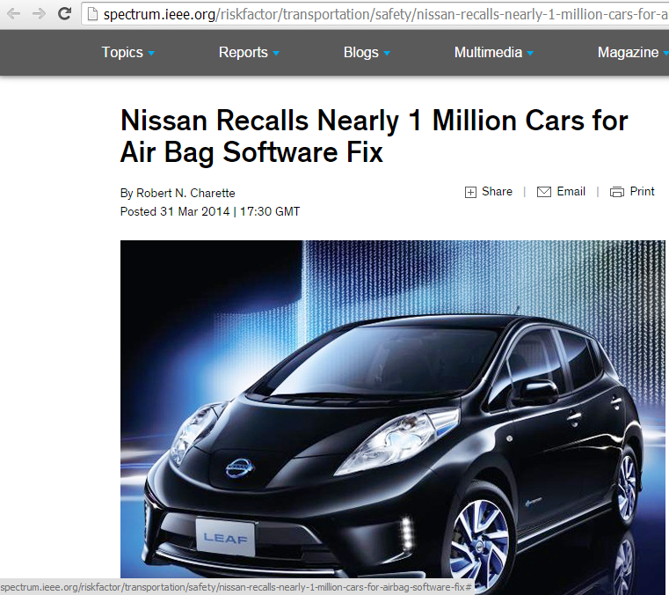
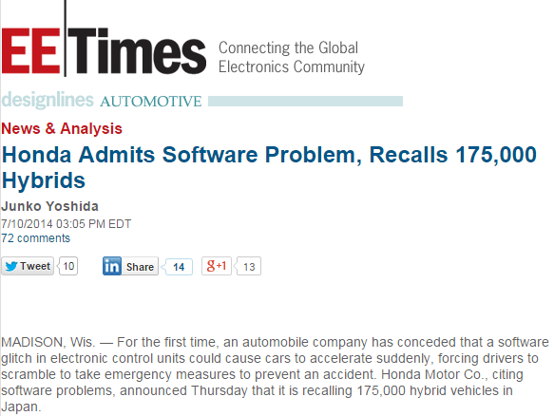
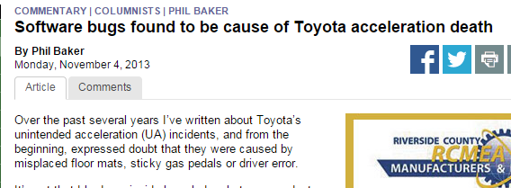
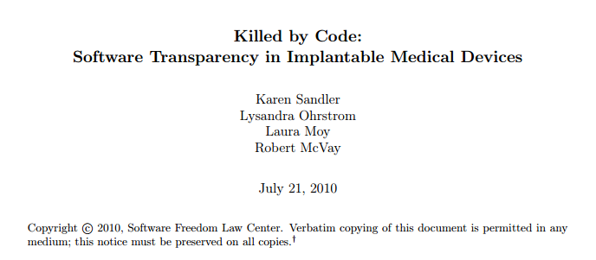
Introduction
Building complex embedded systems is difficult
Notes:
!!!!!! We are going to focus on ground vehicles, but other types of systems are similar…

Slide 4
Introduction
Building complex embedded systems is difficult
Complexity limits traditional verification techniques
Costs, state space explosion, etc.
Runtime verification (RV) is a lightweight technique to provide checking of system at runtime
Handles scaling complexity/abstraction in a nice way
Complementary to other verification techniques!
Notes:
RV also lets us look at different system levels

Slide 5

Runtime Verification (RV)
Runtime verification is the general method of taking an execution trace and a formal policy and deciding if the trace satisfies the policy
Runtime verification generally performed by monitors
Different methods: timed automata, logic-based, petri nets
System
Trace
Monitor
Satisfy/Violate
Verdict
φ
Specification
Notes:
Offline or Online
Can run offline (log checking) or online (runtime)
Many different names, all similar idea

Slide 6
Problem
Existing RV techniques are generally not aimed at safety-critical systems
And especially real-time, distributed, multi-vendor, commercial-off-the-shelf, black-box components
Code instrumentation is common
Safety-critical monitoring constraints (from Pike et. al.)
Functionality
Certifiability
Timing
Size, Weight, and Power (SWaP)
Notes:
The problem is that existing rv techniques are not generally aimed at real-time safety critical systems.
Many of these methods aren’t built to handle real-time, distributed systems.
Many modern complex systems such as cars are built as distributed systems made up of COTS or multi-vendor components that may be black box.
A primary issue is code instrumentation…
They actually change the target system’s code to either add an inline monitor or to expose necessary state. This has two problems. 1) you can’t do code instrumentation on black box systems, and 2) it can affect the system in a bad way.
We’ll focus on goodloe&pike’s FaCTS constraints. Functionality and timing…
----- Meeting Notes (1/14/15 14:09) -----
citation for FaCTS
emphasize SWaP

Slide 7
Thesis Scope
Primary research questions:
How do the constraints of safety-critical embedded systems affect runtime monitoring?
What monitor architectures fit these constraints?
Can we build monitor which fits constraints and can detect useful violations?
Focused on testing
Need good requirements!
Getting them is out of scope
Assuming correct monitor implementation, trusted input
Notes:
These problems bring us to these primary research questions…
----- Meeting Notes (1/14/15 14:09) -----
safety critical embedded constraints

Slide 8
Contributions
Identified suitable RV architecture for safety-critical embedded systems
Provide monitoring framework with formal algorithm and semi-formal system mapping
Demonstrate the feasibility and show performance characteristics of this monitoring framework
Notes:
Passive external broadcast bus monitor
Semi-formal mapping, specification language, algorithms, specification and safety-case patterns
Detect specification violations on logs of real systems under test

Slide 9
Contributions
Identified suitable RV architecture for safety-critical embedded systems
Provide monitoring framework with formal algorithm and semi-formal system mapping
Demonstrate the feasibility and show performance characteristics of this monitoring framework
Passive External Bus Monitor
No Instrumentation
Potentially Bolt-on
Notes:
----- Meeting Notes (1/14/15 14:09) -----
Mention this more!!!

Slide 10
Contributions
Identified suitable RV architecture for safety-critical embedded systems
Provide monitoring framework with formal algorithm and semi-formal system mapping
Demonstrate the feasibility and show performance characteristics of this monitoring framework
Semi-Formal Mapping
Specification Logic
Monitoring Algorithm
Specification Patterns
Safety Case Patterns
Notes:
I provide an end-to-end semi-formal monitoring framework…

Slide 11
Contributions
Identified suitable RV architecture for safety-critical embedded systems
Provide monitoring framework with formal algorithm and semi-formal system mapping
Demonstrate the feasibility and show performance characteristics of this monitoring framework
PC-based Offline Log Monitor
ARM-based real-time CAN Monitor
Checked logs from real systems under test
Autonomous vehicle logs
Potential safety violations detected
Real-time CAN log replay
Specification violations detected

Slide 12
Outline
Motivation
Use Cases
Architecture
Usability Patterns
Intro
Architecture
Formalisms
Monitor Implementation
Monitor Evaluation
Conclusion

Slide 13
Motivation
Emphasized the following constraints
Potentially black-box components
No program instrumentation
Limited observability
Bolt-on monitoring preferred
Connect to unprepared systems
Promotes isolation
Using monitor should not require specialists
Not enough specialists, won’t get used
Minimize overall costs
Additional SWaP, integration, etc.
System Under Observation
X₀
X_{n}
Data Bus Interconnect
Monitor
Monitoring Architecture
External Bus Monitor
(Adapted from [1])
Leads to external bus monitor
Notes:
Gotta go fast
Careful describing formal methods uptake **reluctant**
Why lead to external bus monitor:
other architectures require more instrumentation/alteration
distributed bus mon
extra monitoring bus
----- Meeting Notes (1/14/15 14:09) -----
Careful with formal methods
**Industry reluctant to use formal methods
Why does this imply external bus monitor
as opposed to inline/attached
what other sols were rejected

Slide 14
Use Cases
Test Oracle
Mechanism to determine whether a test passed or failed
Automated oracles support automated testing
Check observable properties, not internal behavior
Runtime Fault Detector
May be able to rely on monitor/recovery for safety, reducing criticality of the rest of the system
Choosing a valid recovery action is difficult
Test Harness
Test Results/Logs
Test
Oracle
Test Control
System
Pass/Fail
Notes:
Can target different abstraction levels or development points

Slide 15
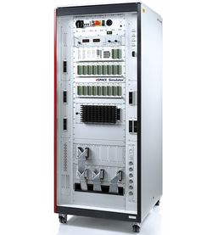
Prototype Test Oracle Example
Used a prototype monitor as test oracle for hardware-in-the-loop vehicle simulator
Tested full-speed range adaptive cruise control feature
Simple rules (e.g., don’t accelerate if too close to target)
Performed black-box robustness testing
Mostly to exercise system
Found violations of the checked rules
Features not designed to be robust
Some caused by inaccurate specification (false positives)
Notes:
An early step was to try out using a monitor as a test oracle.
Early on we used a prototype monitor as a test oracle to perform offline monitoring of a HIL simulator at a commercial research lab.
Overly strict – jitter, sampling issues, etc
----- Meeting Notes (1/14/15 14:09) -----
"Prototype" monitor
Some of them were false positives -- nice
Move infront of explanation stuff

Slide 16
Lessons Learned
External observability is workable
Does limit monitoring
Need flexible mapping control
Message period issues
Discrete value jumps (mode switch/startup)
False positives likely with common specifications
Need very precise specification to avoid this
Can use monitor to explore and refine specification
Notes:
Intent estimation can be difficult…

Slide 17
Architecture Overview
Spec
Target System
System Bus
Informal
Side
Formal
Side
SF
Map
Trace
σ_{i}
φ
Monitor
Algorithm
Warning/Log/Steering
Action
Controller
_{Satisfy/Violate}
Monitor
Notes:
Emphasize!!! External; Semi-Formal

Slide 18
External Monitoring
External monitors have strong isolation
Preserve system functionality/timing
Potential for modular certification
Pay some SWaP costs for isolation
Necessary for strong isolation
Weaker isolation (e.g., independent core) may be ok
Observability issues
Can only monitor values visible on bus
Very system dependent
Notes:
This is an external monitoring architecture…
Sampling-based monitoring
Less intrusive, predictable overhead (avoid event bursts)

Slide 19
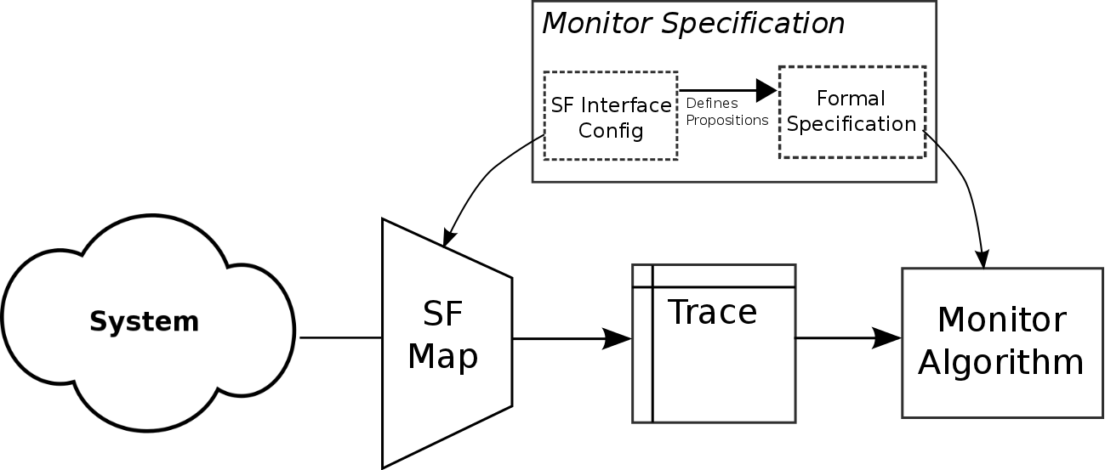
Semi-Formal Monitoring
Interface has two purposes
Convert system state into propositional execution trace
Provide additional semantic power beyond logic
Split specification into two parts
Formal system specification in logic
Semi-formal configuration defines available propositions
Notes:
This architecture is also a semi-formal monitoring architecture…
Need to map system to monitor’s model
Existing monitors use similar interfaces (e.g., MaC filters)
Specification must be able to express desired system properties
Or monitor won’t get used

Slide 20
Semi-Formal Monitoring
Provides flexibility
and power
Notes:
What this does it provide the necessary flexibility and power to monitor a diverse set of systems

Slide 21
Semi-Formal Monitoring
Correctness guarantees
Easier traceability
Provides flexibility
and power
Harder to verify

Slide 22
Semi-Formal Monitoring
Want to specify as much as possible in formal specification
But, better to use some semi-formal aspects than not monitor at all
Correctness guarantees
Easier traceability
Provides flexibility
and power
Harder to verify
Notes:
Verifiable. Unambiguous.
Need to map system to monitor’s model
Existing monitors use similar interfaces (e.g., MaC filters)
Specification must be able to express desired system properties
Or monitor won’t get used
----- Meeting Notes (1/14/15 14:09) -----
There's always stuff you can't put in.

Slide 23
Usability Patterns
Specification patterns help create formal specifications
Safety case pattern provides example of safety case for external monitor integration
Notes:
One of our motivating constraints was to make monitoring easier for non-specialists. So

Slide 24
Specification Pattern

Slide 25
Safety Case
Pattern
G1
C1
External monitor does not introduce additional hazards to target system
System Description
G2
G3
Monitor does not affect system behavior
Monitor actions do not introduce additional hazards
S1
C2
Argument by limits of network interface
System Interface description
Notes:
We also have a safety case pattern. This is an outline of the argument used to show that incorporating an external monitor into a system is safe. It is written in the widely used goal structured notation. The “G” boxes are goals, the rounded “C” boxes are contexts which provide extra information, and the “S” rhombus is a strategy.
This pattern argues that adding an external monitor doesn’t add additional hazards.
----- Meeting Notes (1/14/15 14:09) -----
*general* pattern for external monitors
describe GSN

Slide 26
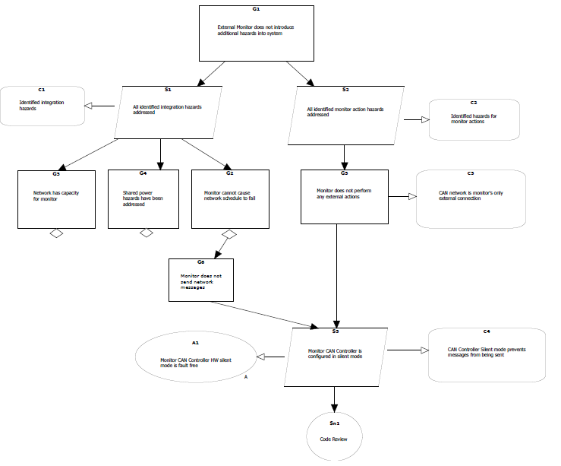
Safety Case Pattern
Monitor actions hazards addressed
No actions which can cause hazards
CAN configured in silent mode, checked by code review
No additional hazards
Integration hazards addressed

Slide 27
Outline
Practical Issues
Algorithm
Intro
Architecture
Formalisms
Monitor Implementation
Monitor Evaluation
Conclusion
Notes:
Now we have this architecture and semi-formal front-end, so let’s look at the actual specification and checking algorithm

Slide 28
Practical Issues
Time-triggered, sampling based monitoring
Predictable overhead, no execution bursts
Event triggered networks can be sampled
Use two-valued logic in a three-valued way
Algorithm delays answering inconclusive questions
Distinguishes good/bad vs inconclusive trace prefixes
Notes:
Time triggered: Need to match this to trace semantics
Sample fast enough to see desired properties
Iterative, formula-rewriting based algorithm
Only need relevant history and current state

Slide 29
Bounded Logic

Slide 30
Algorithm Basics
Algorithm is built on residues and history structures
Primary work is done by the reduce() function
Rewrites residue formula based on history and state
Used recursively over subformula to build up state history
Notes:
Reduce evaluates formulas
----- Meeting Notes (1/14/15 14:24) -----
residue def should be j
i is current timestep, j is step of evaluating residue
Explain reduce in “normal” way – fills in propositions and does syntactic reduction

Slide 31
Aggressive Algorithm
Notes:
Mention what aggressive is.

Slide 32
Algorithm Walkthrough

Slide 33
Algorithm Walkthrough

Slide 34
Algorithm Walkthrough

Slide 35
Algorithm Walkthrough

Slide 36
Algorithm Walkthrough
Notes:
\begin{align*}
%\varphi &= a \rightarrow \underbrace{\lozenge_{[1,1]} (\xoverbrace{\lozenge_{[0,1]} b}^{\phi})}_{\psi} \\ \\
\varphi &= a \rightarrow \xoverbrace{\lozenge_{[1,1]} (\xunderbrace{\lozenge_{[0,1]}\, b}_{\phi})}^{\psi} \\
%\varphi &= a \rightarrow \lozenge_{[1,1]} (\overbrace{\vphantom{\frac{1}{1}} \lozenge_{[0,1]} b}^{\phi}) \\
S^i_{b} &= \rp{0}{\bot}, \rp{1}{\bot}, \rp{2}{\bot}. \rp{3}{\bot} \\%,\rp{4}{\top} \\
S^i_{\lozenge_{[0,1]} b} &= \rp{0}{\bot}, \rp{1}{\bot}, \rp{2}{\bot}, \rp{3}{\phi}\\%, \rp{4}{\top} \\
S^i_{\varphi} &= \rp{0}{\top} , \rp{1}{\bot}, \rp{2}{\psi}, \rp{3}{\psi}\\%, \rp{4}{\top} \\
\end{align*}

Slide 37
Algorithm Walkthrough
Notes:
----- Meeting Notes (1/14/15 14:24) -----
mention 3/4 get solved aggressively
Fix period in figure
\begin{align*}
%\varphi &= a \rightarrow \underbrace{\lozenge_{[1,1]} (\xoverbrace{\lozenge_{[0,1]} b}^{\phi})}_{\psi} \\ \\
\varphi &= a \rightarrow \xoverbrace{\lozenge_{[1,1]} (\xunderbrace{\lozenge_{[0,1]}\, b}_{\phi})}^{\psi} \\
%\varphi &= a \rightarrow \lozenge_{[1,1]} (\overbrace{\vphantom{\frac{1}{1}} \lozenge_{[0,1]} b}^{\phi}) \\
S^i_{b} &= \rp{0}{\bot}, \rp{1}{\bot}, \rp{2}{\bot}. \rp{3}{\bot}, \rp{4}{\top} \\
S^i_{\lozenge_{[0,1]} b} &= \rp{0}{\bot}, \rp{1}{\bot}, \rp{2}{\bot}, \rp{3}{\top}, \rp{4}{\top} \\
S^i_{\varphi} &= \rp{0}{\top} , \rp{1}{\bot}, \rp{2}{\top}, \rp{3}{\top}, \rp{4}{\top} \\
\end{align*}

Slide 38
Formal Monitoring
We have proofs of correctness for this algorithm
Correctness:
If a violation is reported then the trace did violate the specification at that step
Promptness
If a violation exists at least Δ(φ) time ago, then the violation is reported
Guaranteed prompt and correct answer to the question:
Does the execution trace satisfy the given specification?
Still need to build an accurate trace
Still need a good specification

Slide 39
Outline
Intro
Architecture
Formalisms
Monitor Implementation
Monitor Evaluation
Conclusion
Design Constraints
Hybrid Scheme

Slide 40
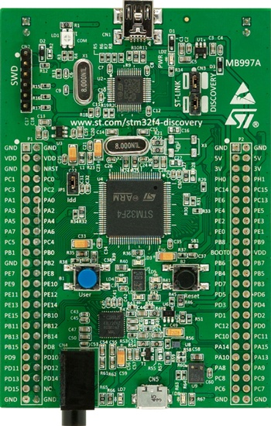
Implementation Overview
Two implementations based on same codebase
PC-based offline CSV log monitor
ARM-based real-time CAN bus monitor
Targeted for real-time embedded:
No dynamic memory allocation
No recursion
Extra optimizations
Interval based history structures
Extended Logic
Hybrid Aggressive/Conservative checking
Notes:
Static memory – avoid memory leaks
No recursion – guaranteed stack depth

Slide 41
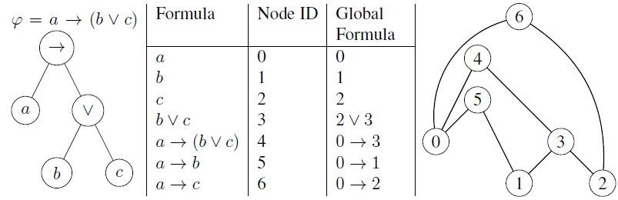
Static Memory
Statically allocate data structures
Bounded logic ➔ known max sizes
Residue formula can be large
History structures can require a lot of storage
Use one global formula instead
Notes:
We don’t want dynamic memory, but the algorithm uses many lists of things

Slide 42
No Recursion
Iterative DFS style reduce()
Use traversal stacks since we cannot mark the global tree

Slide 43
Algorithm Optimizations
Implemented two high-value optimizations
Interval history structures
Decrease worst-case runtimes
Extra logic operators
Save formula storage space
Save some execution time
Interval
Lists
Residue
List
Notes:
Intervals decrease average storage space
doesn’t help with static allocation

Slide 44
Hybrid Scheme
Aggressive checking can provide early detection of temporal rules
But, it’s much more computationally expensive
May not always be able to keep up with real-time
Can be very bursty – depends on trace
Conservative checking has slower response time but relatively constant and shorter execution time
Only check residues older than delay, guaranteed evaluation
Idea: Combine the approaches
Obtain worst-case guarantees from conservative
Use extra time to do as much aggressive checking as possible

Slide 45
A little scheduling
Essentially a multi-tasking system with 4 tasks:
Some blocking to share structures, all straightforward
Task | Priority | Location
Trace Update | Highest | CAN receive ISR
Structure Update | High | Timer 2 ISR
Conservative Check | High | Timer 2 ISR
Aggressive Check | Low | Main loop
Notes:
----- Meeting Notes (1/14/15 14:24) -----
Structure Update

Slide 46
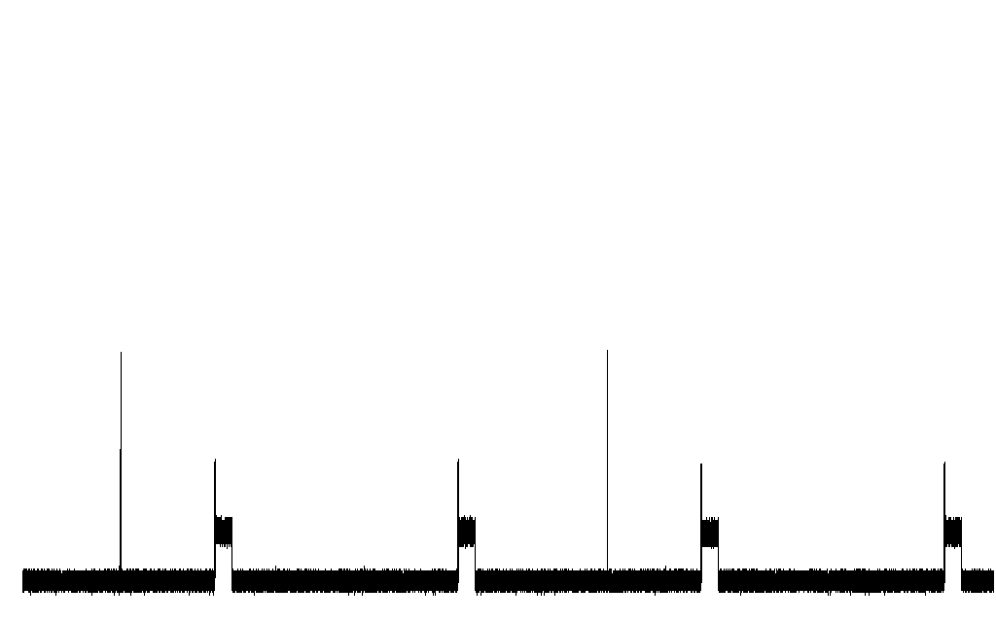
Hybrid in action
Simple lab bench setup with instrumentation
One 100ms CAN message (would see more data in a real system)
Checking 200 residues (<0,200> val) on top of heartbeat rules
~23ms idle with 25ms loop
Trace Update
Conservative Check
Aggressive Check
Idle
Notes:
----- Meeting Notes (1/14/15 14:24) -----
grid lines

Slide 47
Outline
Intro
Architecture
Formalisms
Monitor Implementation
Monitor Evaluation
Conclusion
Offline Vehicle Logs
Replayed CAN Logs
Notes:
SHOULD BE AROUND 48 minutes!
~11 minutes from here to end

Slide 48
Offline Vehicle Log Checking
Logs from test drive of autonomous research vehicle
Approximately 16 hour drive
Primarily looking at lane centering feature
Ad-hoc rule elicitation
Not much info available

Slide 49
Monitored Rules
No violations of Rule #0
Violations of Rules #1/2
Didn’t always match – sensor accuracy is important
Need more info to know if these are real problems
Notes:
----- Meeting Notes (1/14/15 14:24) -----
disengaged -- debouncing

Slide 50
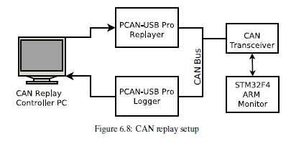
Embedded Replay
Real-time replay of CAN logs from system robustness testing
<0.01% average message timing error
Sub-ms absolute error (fast enough for 25ms monitoring)
Had some system documentation
Real derived rules!

Slide 51
Monitor Specification

Slide 52
Monitoring Results
Detected Heartbeat and transition violations
Three heartbeat violation types detected
Late/missing heartbeat
Real violation
On-time heartbeat with heartbeat status set to 0
May be a problem
Bad heartbeat counter value
False positive caused by test controlled messages
Transition violations were also test-induced FP
Notes:
----- Meeting Notes (1/14/15 14:24) -----
Test-rig caused false positive -- induced by design
not monitor caused

Slide 53
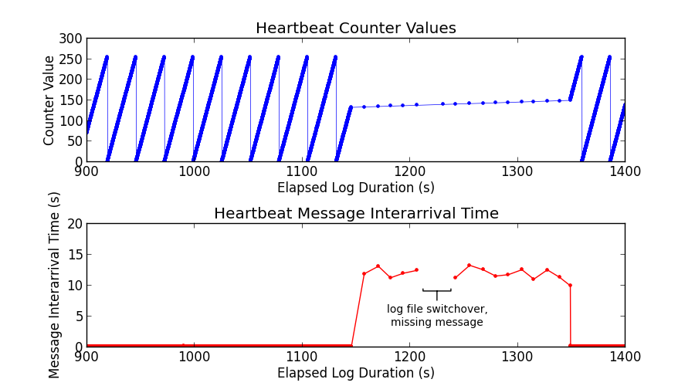
Late Heartbeat
Unclassified: Distribution A: Approved for Public Release. OPSEC review #26162

Slide 54
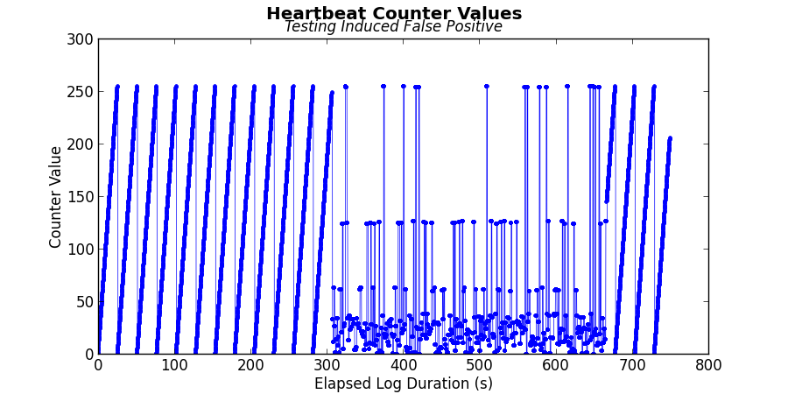
Bad Counter
Invalid Counter
Unclassified: Distribution A: Approved for Public Release. OPSEC review #26162
Notes:
----- Meeting Notes (1/13/15 22:54) -----
put invariant on slide?

Slide 55
Outline
Intro
Architecture
Formalisms
Monitor Implementation
Monitor Evaluation
Conclusion
Future Work
Conclusion
Notes:
Detected violations of realistic properties on real system logs
FEASIBLE!
Specification quality is very important

Slide 56
Future Work
Recovery
Hard to do safely
Emergency stop not always best choice
Prefer to controlled stop if possible
Need to diagnose faults to choose viable recovery
Semi-formal Specification Language
More formal definition of interface between system and monitor
Domain Specific Language can be designed to help verification of interface

Slide 57
Conclusions
Identified suitable RV architecture
Provided an end-to-end monitoring framework for safety-critical embedded
Real-time monitoring of CAN networks is feasible
Passive External Bus Monitor
Handles Black-box components
No Instrumentation
Potentially Bolt-on

Slide 58
Conclusions
Identified suitable RV architecture
Provided an end-to-end monitoring framework for safety-critical embedded
Real-time monitoring of CAN networks is feasible
Semi-formal mapping
Specification Logic
Algorithms
Correctness Proofs
Specification Patterns
Safety Case Patterns

Slide 59
Conclusions
Identified suitable RV architecture
Provided an end-to-end monitoring framework for safety-critical embedded
Real-time monitoring of CAN networks is feasible
Checked logs from real systems under test
Found potential violations in offline logs from autonomous research vehicle
Detected violations on CAN bus

Slide 60
Questions?
Thank you
[1] Goodloe, A. & Pike, L. Monitoring distributed real-time systems: a survey and future directions NASA Langley Research Center, 2010

Slide 61
Extras

Slide 62
Info Extras
Keeping these for now, just because

Slide 63
Evaluation Overview
Detected violations of realistic properties on real system logs
Both offline logs and live CAN
This type of monitoring is feasible
Specification quality is very important
“Accuracy” affects false positive rate
Take initialization into account

Slide 64
Optimization/Scalability Check
Using PC-based implementation
Artificial logs (all false/true, alternating, etc)
See how optimizations and algorithm works

Slide 65
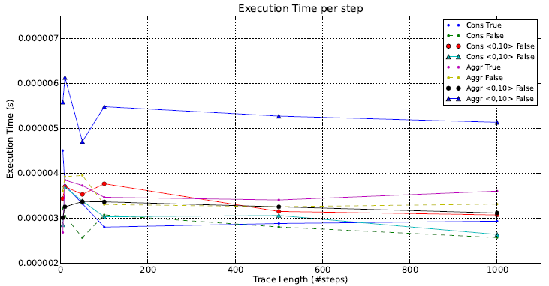
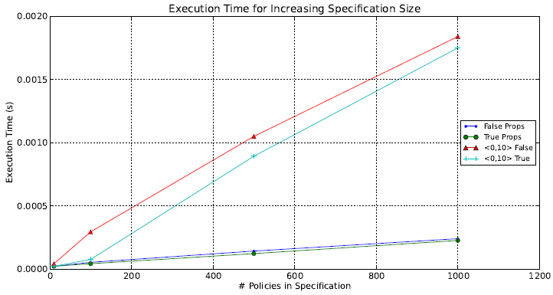

Slide 66
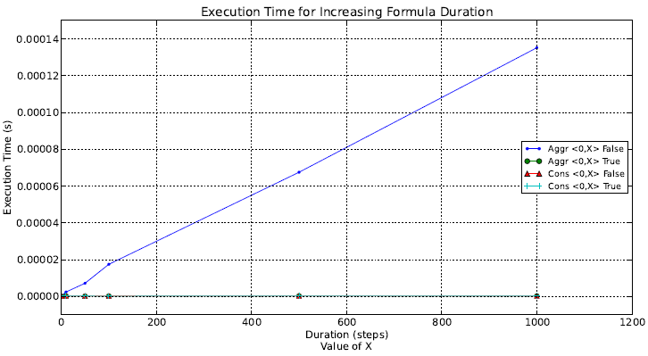
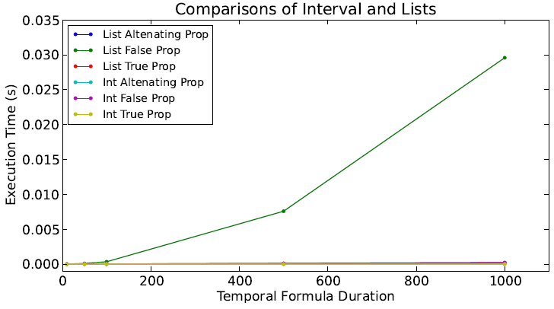

Slide 67
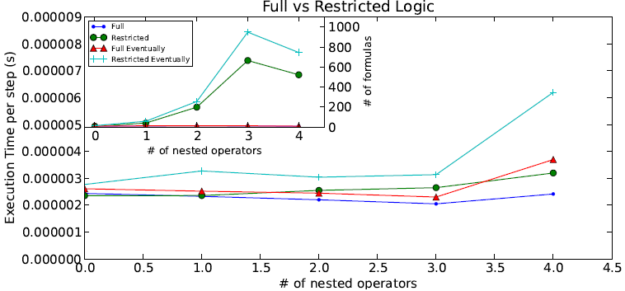

Slide 68
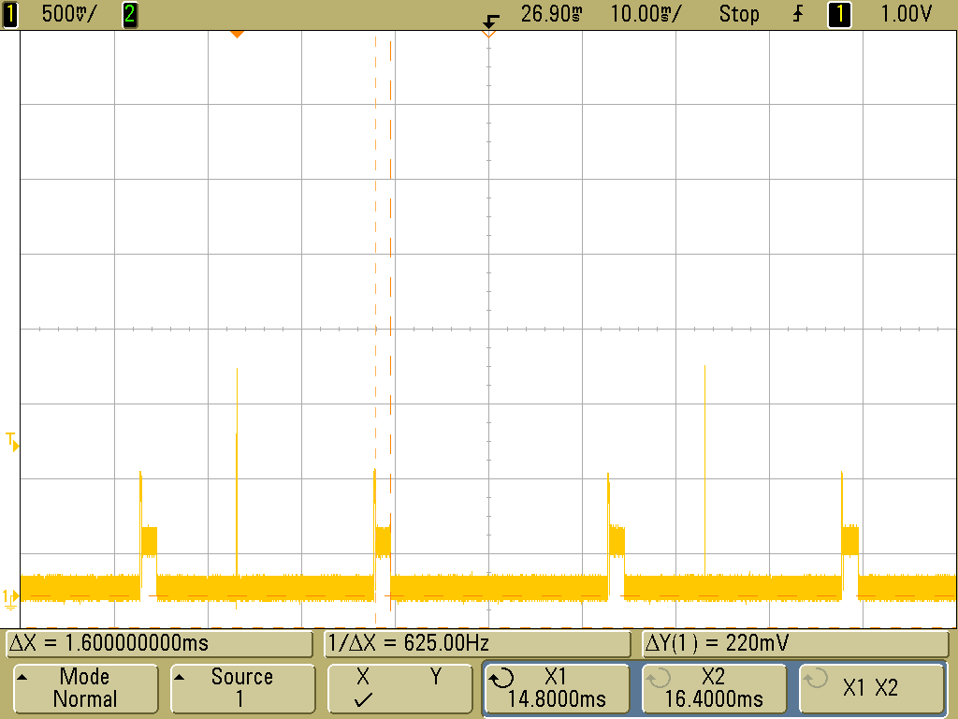

Slide 69
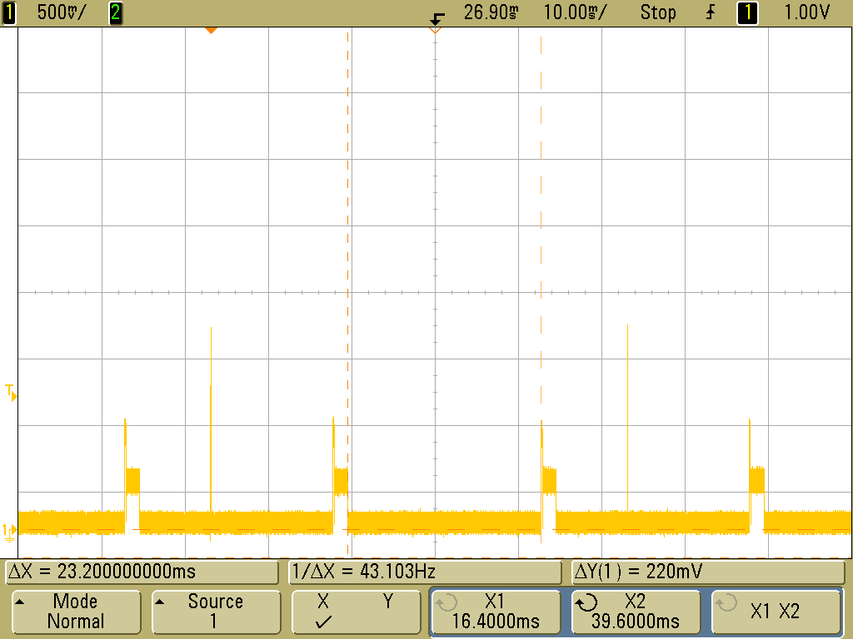

Slide 70
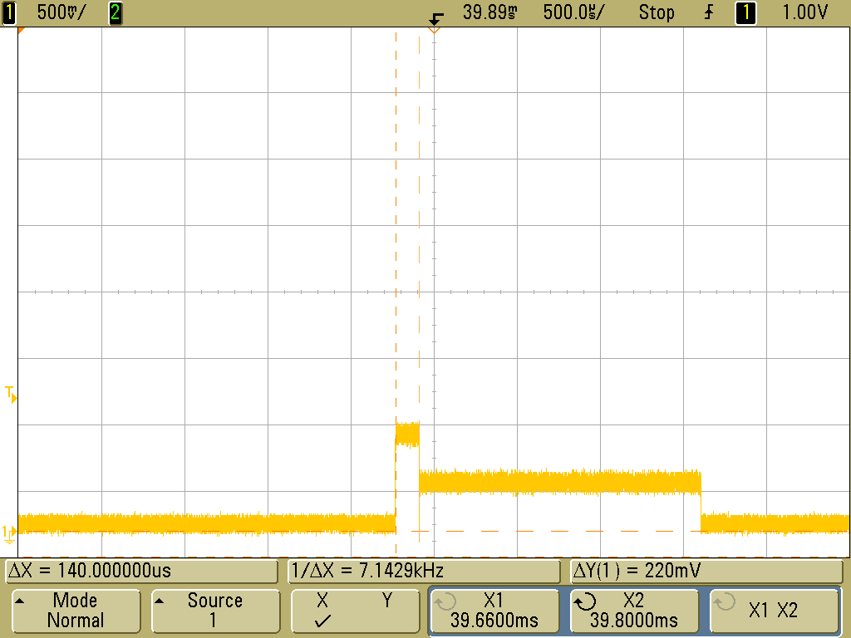

Slide 71
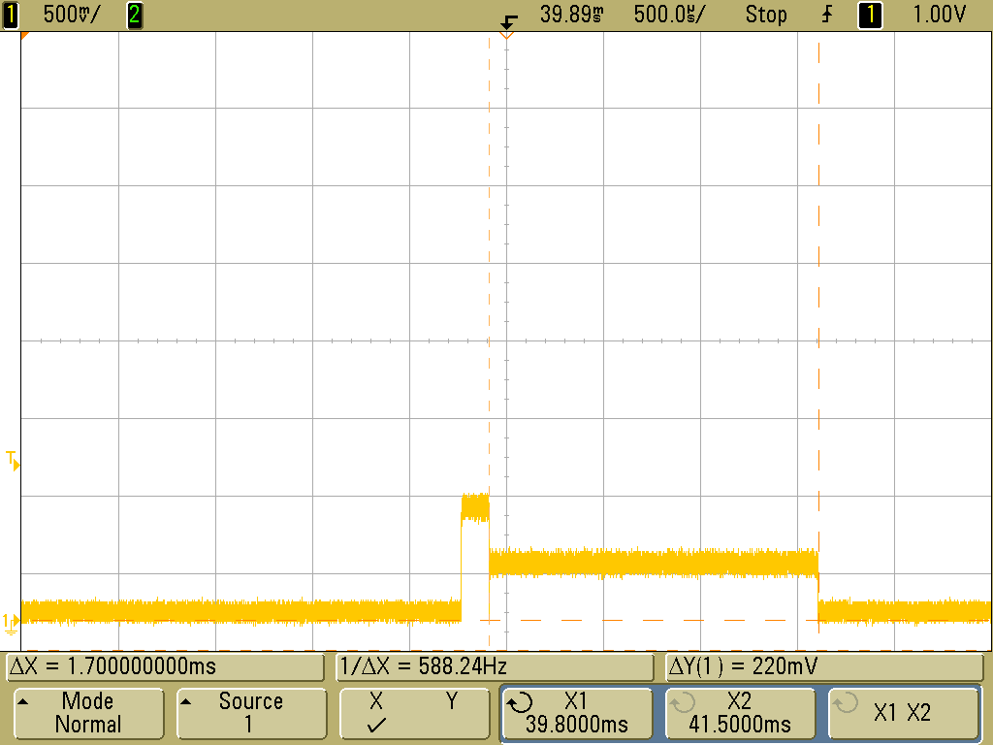

Slide 72
Practical Issues
Time-triggered, sampling based monitoring
Predictable overhead, no execution bursts
Event triggered networks can be sampled
Iterative, formula-rewriting based algorithm
Only need relevant history and current state
Use two-valued logic in a three-valued way
Algorithm delays answering inconclusive questions
Distinguishes good/bad vs inconclusive trace prefixes
X:
F
F
T
T
F
F
0
1
2
3
4
5
Notes:
Time triggered: Need to match this to trace semantics
Sample fast enough to see desired properties
Bounded logic and “real” time – trace will progress
----- Meeting Notes (1/14/15 14:09) -----
add bullet -- sample into event triggered
better discussion of prefixes -- how does two-valued logic work
Need example of two-valued logic in three-valued way
“it will rain today or tomorrow” Yes/No

Slide 73
PROOF STUFF

Slide 74
Wait Delay

Slide 75
Storage Delay

Slide 76
Residue Properties

Slide 78
Algorithm
Notes:
\begin{algorithmic}[1]
%\STATE Recognize formulas for which we build structures
\STATE For all recognized formulas $\psi \in \mathbf{tempSub}(\varphi)$: $S^{-1}_{\psi} \leftarrow \emptyset$
\STATE $S^{-1}_\varphi \leftarrow \emptyset$
\STATE $i \leftarrow 0$
\LOOP
\STATE Obtain $(\sigma_i,\tau_i$ from trace
\STATE Extend $\tau$ with next timestamp $\tau_i$
%\STATE Obtain $(\sigma_i,\tau_i)$ from trace
\FOR{every $\psi \in \mathbf{tempSub}(\varphi)$ in increasing size}
\STATE $S^i_{\psi} \leftarrow \mathbf{incrS(} S^{i-1}_{\psi}, \mathbb{S}^i_{\psi}, \sigma_i, \tau, i)$
\ENDFOR
\STATE $S^i_{\varphi} \leftarrow \mathbf{incrS(} S^{i-1}_{\varphi}, \mathbb{S}^i_{\varphi}, \sigma_i, \tau, i)$
\FOR{all $\rp{j}{\bot} \in S^i_{\varphi}$}
\STATE \texttt{Report violation on $\sigma$ at position $j$}
\ENDFOR
\STATE $i \leftarrow i + 1$
\ENDLOOP
\end{algorithmic}

Slide 79
Reduce
Notes:
\begin{align*}
\mathbf{reduce}(\sigma_i,\tau, i,\mathbb{S}^i_{\top},\rp{j}{\top}) &= \rp{j}{\top} \\
\mathbf{reduce}(\sigma_i,\tau, i,\mathbb{S}^i_{\bot},\rp{j}{\bot}) &= \rp{j}{\bot} \\
\mathbf{reduce}(\sigma_i,\tau, i,\mathbb{S}^i_{p},\rp{j}{p}) &= \rp{j}{\sigma_i(p)} \\
\end{align*}
\begin{align*}
\mathbf{reduce}(\sigma_i,\tau, i,\mathbb{S}^i_{\neg \psi},\rp{j}{\neg \psi}) = \left\{
\begin{aligned}
\text{Let } &\psi' \leftarrow \mathbf{reduce}(\sigma_i, \tau, i, \mathbb{S}^i_{\psi}, \rp{j}{\psi}) \\
&\psi'' \leftarrow \mathbf{simplify}(\neg \psi') \\
&\textbf{return } \rp{j}{\psi''} \\
\end{aligned} \right. \\
\end{align*}
\begin{align*}
\mathbf{reduce}(\sigma_i,\tau, i,\mathbb{S}^i_{\alpha \vee \beta},\rp{j}{\alpha \vee \beta}) = \left\{
\begin{aligned}
\text{Let } &\alpha' \leftarrow \mathbf{reduce}(\sigma_i, \tau, i, \mathbb{S}^i_{\alpha}, \rp{j}{\alpha}) \\
&\beta' \leftarrow \mathbf{reduce}(\sigma_i, \tau, i, \mathbb{S}^i_{\beta}, \rp{j}{\beta}) \\
&\phi' \leftarrow \mathbf{simplify}(\alpha' \vee \beta') \\
&\textbf{return } \rp{j}{\phi'} \\
\end{aligned} \right. \\
\end{align*}

Slide 80
Reduce (until)
Notes:
%%% TAU UNTIL
\begin{align*}
\mathbf{reduce}(\sigma_i,\tau, i,\mathbb{S}^i_{\alpha\, \mathcal{U}_{[l,h]}\, \beta} ,\rp{j}{\alpha\, \mathcal{U}_{[l,h]}\, \beta}) = \left\{
\begin{aligned}
&\text{let } a_a \leftarrow min(\{k | \tau_j \leq \tau_k \leq \tau_j+h \wedge \rp{k}{\bot} \in S^i_\alpha \},i) \\
% a_u
& a_u \leftarrow min({k| \tau_j \leq \tau_k \leq \tau_j+h \wedge \rp{k}{\alpha'} \in S^i_\alpha \wedge \alpha' \not\equiv \top},i) \\
% b_a
& b_a \leftarrow min(\{k | \tau_j+l \leq \tau_k \leq \tau_j+h \wedge \rp{k}{\beta'} \in S^i_\beta \wedge \beta' \neq \bot\}) \\
% b_t
&b_t \leftarrow min(\{k | \tau_j+l \leq \tau_k \leq \tau_j+h \wedge \rp{k}{\top} \in S^i_{\beta} \}) \\
% b_n
&b_n \leftarrow \top \text{ if } (\tau_i - \tau_j \geq \Delta^w(\psi)) \\ & \quad \quad \quad \quad \quad \wedge \forall k.(\tau_j+l \leq \tau_k \leq \tau_j+h). \rp{k}{\bot} \in S^i_{\beta} \\
&\text{if } b_t \neq \emptyset \wedge a_u \geq b_t \\
& \quad\mathbf{return} \rp{j}{\top} \\
&\text{else if } (b_a \neq \emptyset \wedge a_a < b_a) \text{ or } b_n = \top\\ & \quad\mathbf{return} \rp{j}{\bot} \\
&\text{else} \\
& \quad\mathbf{return} \rp{j}{\alpha\, \mathcal{U}_{[l,h]}\, \beta}
\end{aligned} \right. \\
\end{align*}

Slide 81
Reduce (since)
Notes:
%%% TAU SINCE
\begin{align*}
\mathbf{reduce}(\sigma_i,\tau, i,\mathbb{S}^i_{\alpha\, \mathcal{S}_{[l,h]}\, \beta} ,\rp{j}{\alpha\, \mathcal{S}_{[l,h]}\, \beta}) = \left\{
\begin{aligned}
&\text{let } a_a \leftarrow max(\{k | \tau_j-h \leq \tau_k \leq \tau_j \wedge \rp{k}{\bot} \in S^i_\alpha \},i) \\
% a_u
& a_s \leftarrow max({k| \tau_j-h \leq \tau_k \leq \tau_j \wedge \rp{k}{\alpha'} \in S^i_\alpha \wedge \alpha' \not\equiv \top},i) \\
% b_a
& b_a \leftarrow max(\{k | \tau_j-h \leq \tau_k \leq \tau_j-l \wedge \rp{k}{\beta'} \in S^i_\beta \wedge \beta' \neq \bot\}) \\
% b_t
&b_t \leftarrow max(\{k | \tau_j-h \leq \tau_k \leq \tau_j-l \wedge \rp{k}{\top} \in S^i_{\beta} \}) \\
% b_n
&b_n \leftarrow \top \text{ if } (\tau_i - \tau_j \geq \Delta^w(\psi)) \\ & \quad \quad \quad \quad \quad \wedge
\forall k.(\tau_j-h \leq \tau_k \leq \tau_j-l). \rp{k}{\bot} \in S^i_{\beta} \\
%%
&\text{if } b_t \neq \emptyset \wedge a_s \leq b_t \\
& \quad\mathbf{return} \rp{j}{\top} \\
&\text{else if } (b_a \neq \emptyset \wedge a_a > b_a) \text{ or } b_n = \top\\ & \quad\mathbf{return} \rp{j}{\bot} \\
&\text{else} \\
& \quad\mathbf{return} \rp{j}{\alpha\, \mathcal{S}_{[l,h]}\, \beta}
\end{aligned} \right. \\
\end{align*}

Slide 82
IncrS is correct
Notes:
\begin{align*}
\mathbf{incrS}(S^{i-1}_\psi, \mathbb{S}^i_{\psi}, \sigma_i, \tau, i) = %\left\lbrace
%\begin{aligned}
\left(\bigcup\limits_{r \in S^{i-1}_{\psi}} \mathbf{reduce}(\sigma_i, \tau, \mathbb{S}^i_{\psi}, r)\right) \cup \mathbf{reduce}(\sigma_i, \tau, \mathbb{S}^i_{\psi}, \rp{i}{\psi})
%\end{aligned} \right.
\end{align*}
For all states traces $\sigma$, timestamp series $\tau$, timesteps $i$, formulas $\psi$, correct, prompt, and reducible structures $S^{i-1}_{\psi}$, and correct and prompt $\mathbb{S}^i_{\psi}$
if $S^i_{\psi} \leftarrow \mathbf{incrS(}(S^{i-1}_{\psi},\mathbb{S}^i_{\psi}, \sigma_i, \tau_i, i)$ then $S^i_{\psi}$ is correct, prompt, and reducable.
\textit{Proof}. Follows from $\mathbf{reduce}(\ldots)$ preserving correctness/promptness/reducability. \\
%
Since $S^{i-1}_\psi$ is correct/prompt/reducable, it has a residue entry for all $k \in [0,i-1]$ which are all c/r/p. $\mathbf{incrS}(\ldots)$ adds the residue for $i$, so $S^i_\psi$ has all the necessary residues. All the residues from $S^{i-1}$ are c/r/p because $\mathbf{reduce}(\ldots)$ preserves c/r/p. The new reduced residue $\rp{i}{\psi}$ is also c/r/p from the correctness of $\mathbf{reduce}(\ldots)$: $\mathbb{S}^i_\psi$ is correct and prompt, and $i=j$.

Slide 83
Reduce is correct
Notes:
For all timesteps $i,j$ where $j\leq i$, formulas $\phi,\psi$, traces $\sigma$, timestamp series $\tau$, and history structures $\mathbb{S}^i_{\psi}$ such that $\mathbb{S}^i_{\psi}$ is correct/prompt/reducible and $\rpt{j}{\phi}{\psi}$ is reducible at $i$ then if
$\rp{j'}{\phi'}_{\psi} \leftarrow \mathbf{reduce}(\sigma_i,\tau,i,\mathbb{S}^i_{\psi}, \rpt{j}{\phi}{\psi})$, $\rpt{j}{\phi'}{\psi}$ is correct/prompt/reducible.
\textit{Proof}. Proof by mutual induction. \\
%
$\mathbf{reduce}(\ldots)$ is trivially c/r/p for $\top,\bot$ residues. \\ \\
Case $\phi \equiv p$: Since the residue is reducible and there is a free proposition, we know that $i = j$. From definition of reduce, we'll get $\vDash \sigma_i(p) \leftrightarrow \vDash p$. \\ \\
Case $\phi \equiv \neg \psi_1$: Follows from correctness of reduce and simplify. \\ \\
Case $\phi \equiv \psi_1 \vee \psi_2$: Follows from correctness of reduce and simplify. \\ \\

Slide 84
Reduce is correct (cont)
Notes:
\textit{Proof}. Proof by mutual induction. \\
%
Case $\phi \equiv \alpha \mathcal{U}_{[l,h]} \beta$: Two subcases: $\vDash \phi \rightarrow \vDash \phi'$ and $\vDash \phi' \rightarrow \vDash \phi$ \\ \\
Subcase $\vDash \phi \rightarrow \vDash \phi'$: From semantics of $\mathcal{U}$ we know that there exists a $k$ where $\beta = \top$ in the bounds and for all $\tau_k'$ where $k' \in [j,k-1]$ we have $\alpha = \top$. Looking at the definition of reduce we see that $a_u \geq b_t$ so $\phi' = \top$. \\ \\
%
Subcase $\vDash \phi' \rightarrow \vDash \phi$: There are three sub cases here, $\phi' = \top, \bot, \phi$. The $\bot$ and $\phi$ cases are trivial so we look at the $\top$ case. In this case, $a_u \geq b_t$ and $b_t \neq 0$ so we know there exists a $k$ where $\tau_k \in [\tau_j+l,\tau_j+h]$ and $\rp{k}{\top} \in S^i_\beta$. Since $S^i_\beta$ is correct, we know that $\sigma, \tau, k \vDash \beta$. From $a_u$ we know that all $\forall k'.(\tau_j \leq \tau_k' < a_u).\rp{k'}{\tau} \in S^i_\alpha$. Since $S^i_\alpha$ is correct and $a_u \geq b_t$ we know that $\forall k'.(\tau_j \leq \tau_{k'} < b_t). \sigma, \tau, k' \vDash \alpha$. From the semantics of $\mathcal{U}$, we see that $\sigma, \tau, j \vDash \alpha \mathcal{U}_{[l,h]} \beta$.

Slide 85
Reduce Promptness
Notes:
\textbf{Proof.} Promptness of $\mathbf{reduce}(\ldots)$ requires that given $\rp{j}{\phi'}$ at step $i$, $(\tau_i - \tau_j) \geq \Delta^{\omega}(\psi) \rightarrow \phi' \in \{\top,\bot\}$. \\ \\
%
There are two top-level cases, either there is no true $\beta$ residue or a true $\beta$ residue exists. \\ \\
%
Subcase no-$\beta$: In this case, $\forall k. (\tau_{j}+l \leq \tau_k \leq \tau_j+h). \rp{k}{\bot} \in S^i_\beta$. If this is true and $\tau_i-\tau_j \geq \Delta^{\omega}(\psi)$ then we see from the definition of reduce that $b_n = \top$ and so $\phi' = \bot$. \\ \\
%
Subcase $\beta$ exists: In this case, $\exists k.(\tau_j+l \leq \tau_k \leq \tau_j+h). \rp{k}{\psi'} \in S^i_\beta$ and $\psi' \neq \bot$. Since $\tau_k \in [\tau_j+l,\tau_j+h]$ and $\tau_i-\tau_j \geq \Delta^\omega(\phi)$ we know that $\tau_i-\tau_k \geq \Delta^\omega(\beta)$ and so $S^i_\beta$ is prompt at $k$. This means that $\psi' = \top$. and then in $\mathbf{reduce}(\ldots)$, $b_a \leq k$ and $b_t = b_a$. \\ \\
%
From here we have to more sub cases, either $\alpha$ is true until $\beta$ or it's not. \\ \\
%
Subcase not $\alpha$ until $\beta$: In this case, if $\exists k' \in [j,b_a-1]. \rp{k}{\bot} \in S^i_{\alpha}$ then from the definition of $\mathbf{reduce}$ we can see that $a_a < b_a$ and so $\phi' = \bot$ \\ \\
%
Sub-Subcase $\alpha$ until $\beta$:
Otherwise, $\forall k' \in [j,b_a-1]. \rp{k}{\top} \in S^i_\alpha$ (due to promptness of $S^i_\alpha$). From the definition of $\mathbf{reduce}$ we can see that $a_u \geq b_a = b_t$ so $a_u \geq b_t$ and $\phi' = \top$.

Slide 86
Discussion
Monitor correctness
Implementation
Input data
Consolidation
Trade off isolation guarantees for cost

Slide 87
Eval Lessons Learned
Optimizations matter for real-world performance
Specification quality depends heavily on documentation
Detection accuracy (esp. FP issues) depends on good specification
Specifications must also take initialization and modes into account
Notes:
----- Meeting Notes (1/13/15 22:54) -----
get rid of this slide too

Slide 88
Monitor as Diagnostic Tool
Check that ACC attempts to recover headway
(VehInPath && HeadwayLT2s) -> <0,200> [0,100] ~ACCAccel
Found violations with this rule
So loosened bound durations (500ms, then 1s eventually)
Most violations removed with this tuning, but a few still there
Either our rule does not describe the desired behavior or there is a real problem here
Need more design info to be sure, worth bringing up

Slide 89
Embedded Monitor
$15 retail ARM based Dev board
Moderately overpowered for our needs
Useful while we’re exploring
32-bit CPU up to 168Mhz
1MB flash, 192kb RAM, peripherals, etc

